Slide 1




EV Charging at Multi-Unit Dwellings
(Presenter/ Conference)

Slide 2



Clean Cities Coalition Network
Building partnerships to advance affordable, domestic transportation fuels and technologies
Serve as forums for local stakeholders to connect and collaborate on saving energy and using affordable alternative fuels
Provide grassroots support and resources on new transportation technologies and infrastructure development
Support networks to help their stakeholders identify cost-effective solutions that work locally
Notes:
The Clean Cities Coalition Network is a coordinated group of nearly 100 coalitions that work in communities across the country to help local decision makers and fleets understand and implement alternative and renewable fuels, idle-reduction measures, fuel economy improvements, new mobility choices, and emerging transportation technologies.
Clean Cities coalitions foster the economic, environmental, and energy security of the United States by working locally to advance affordable, domestic transportation fuels, energy efficient mobility systems, and other fuel-saving technologies and practices.
Coalitions accomplish this mission by building partnerships with public- and private-sector transportation stakeholders.
Photo from iStock 155395910

Slide 3
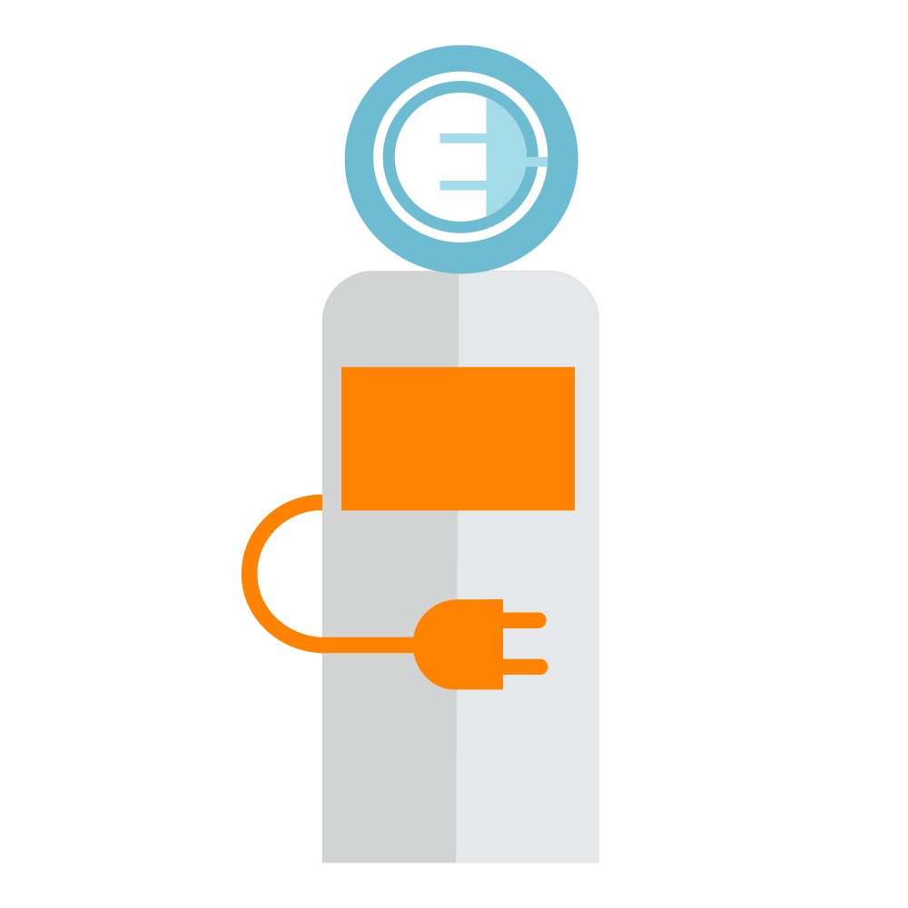
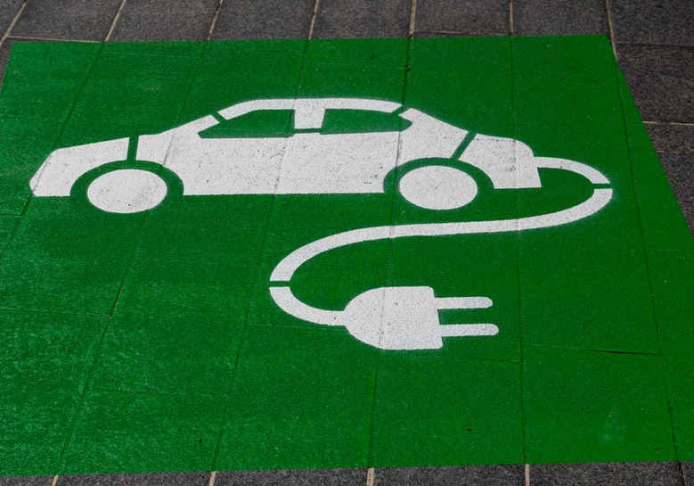



Presentation Overview for MUD Key Stakeholders
Building Owners/Managers and HOA Decision-Makers
EV 101/Charging 101
Why you should Install Charging at your MUD
Project Overview and Project Learnings
Website Toolkit and Resources (July 2022)

Slide 4
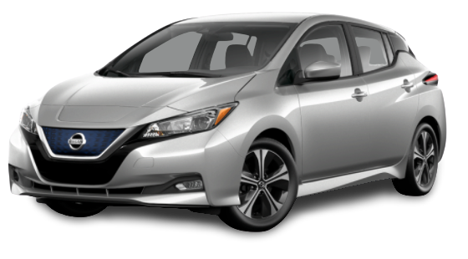
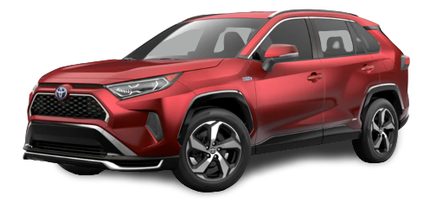
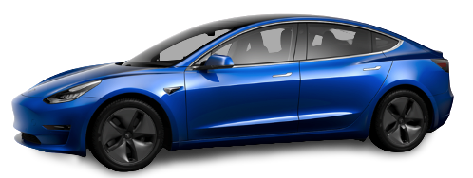
Electric Vehicle Types
Plug-in Hybrid Vehicle (PHEV):
Battery Electric Vehicle (BEV):
  Both electric and gasoline powered
  Most have an “Electric Only” mode
  Plug-in to recharge, fill tank when needed
  100% electric, completely battery powered
  Plug-in to recharge
  Example: Chevy Bolt EV, VW ID.4, All Teslas, Ford F150 Lightning (Tesla Model 3 pictured), Nissan Leaf (pictured)
  Example: Toyota RAV4 Prime (pictured), Kia Niro PHEV, Honda Clarity PHEV, Chevy Volt
Notes:
An electric vehicle is a vehicle-powered in part or entirely from electricity. All of these vehicles have plugs on them and are collectively referred to as plug-in electric vehicles, this excludes hybrids like the Honda Civic Hybrid and regular Toyota Prius.
Battery Electric Vehicles: Currently, most battery electric vehicles have battery packs that range from 24 kW in a Fiat 500e to 30 kW in a Nissan LEAF to a 60kW battery in a Chevy Bolt. Depending on how you drive and the conditions you are driving in, these vehicles can go 2-4 miles/kW meaning that they have ranges of about 80-240 miles.
Plug-in Hybrid Electric Vehicles: These have a smaller battery and operate like traditional hybrids where a gasoline engine and electric motor both work to power the wheels. The new Prius Prime has an “all-electric mode” where you can go around 15-20 miles with just electricity. If your commute is 5-7 miles, than this may be a good option for you.
Conventional Hybrids: The most popular EVs historically, conventional hybrids have both a gasoline engine and an electric motor, but the electric battery cannot be charged by plugging a cable into an outlet. Instead, batteries in conventional hybrids are charged using regenerative braking, which captures the kinetic energy that is generated during braking and converts it into electricity. Since conventional hybrids cannot plug into the electric grid, they are not the focus of this project.
Miles per kWh is the equivalent to MPG

Slide 5


Level 1 Charging
Best for folks with short commutes or short ranges
120 Volt Outlet
Standard Port
Use Case?
Overnight home charging
Plug-in Hybrids
Notes:
You can plug a level 1 into any grounded 110v outlet
Fine for plug-in hybrid
Every car comes with one of these in the trunk or somewhere in the car for emergencies and home use
Slowest rate of charge

Slide 6

Level 2 Charging
3-8x faster than Level-1 charging
  (10-40 miles per hour added, average 25)
240 Volt Outlet (dryer plug)
Standard Port
(Teslas have an adapter)
Use Case?
Public chargers
Homes
MUDs
Workplaces
Notes:
These are generally what you may have seen before
Like what a dryer or hot tub would use.
These are the chargers that people install both at home and in public places like malls, grocery stores, etc.
Many hotels also provide these chargers for overnight guests—Tesla even has a program that allows you to apply for free destination chargers
If you’re installing these at a MUD, you may have to do more electrical work if the building is older, well discuss more on that later in the presentation.

Slide 7



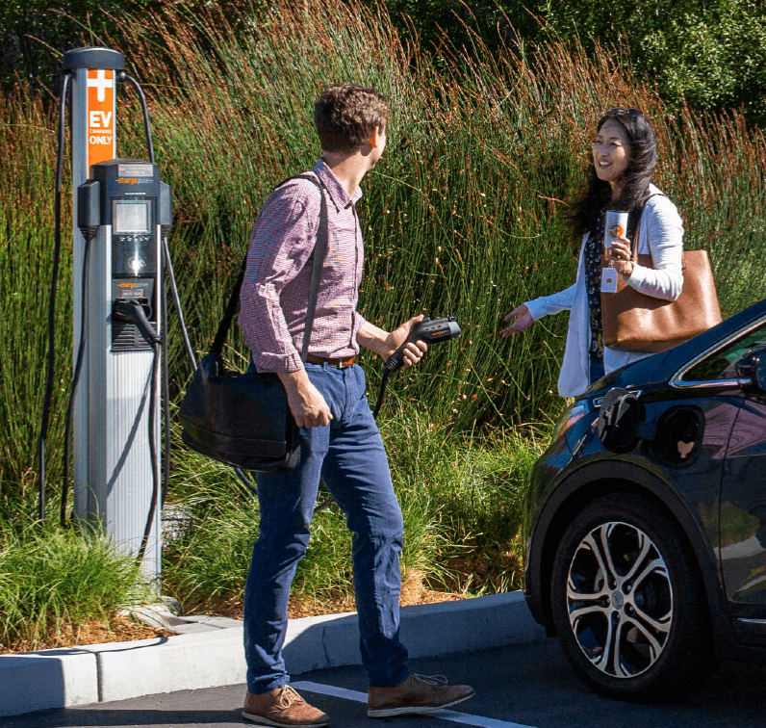
Networked (Smart) Level-2 Charging
Networked chargers are connected to the net
  Cellular Signal | Wi-fi | Ethernet
240 Volt Outlet (dryer plug)
Standard Port
(Teslas have an adapter)
Enables features such as:
Payment options-via phone app/credit card/fob
Access restrictions
Reservation systems
Notifications
Rate design (per kWh, hr, etc.) and Idle fees
Backend data metering/remote monitoring
Power control/sharing (Sometimes)
Remote Servicing
Use Case?
Public chargers
MUDs
Workplaces
Notes:
Still just the standard port.
A networked charger is essentially a “smart” charger.
Allows for several features that are useful if the charger is shared by several users.
A small networking fee will apply but networked chargers can save you money through the features it enables, for example, power sharing.
Networked chargers make the management of chargers much easier.

Slide 8



DC-Fast Charging (Level 3)
3 different plug shapes:
80% charge in 20-50 minutes (Depending on charger/vehicle)
Fast charging is (other than Tesla) standardizing on CCS/SAE*
Tesla
Only Teslas for now
CHAdeMO
Nissan Leafs
*CCS/SAE
American/
European Cars
Use Case?
Shopping Centers
Highway Corridors
EV Charger Hubs
Notes:
DCFC is becoming the standard for public charging
These chargers are the fastest level of chargers available and bypass a car’s onboard charger and are therefore called direct current fast chargers.
They are best used for road trips and in emergencies and not on a regular basis. That being said, people who drive for a living like Uber and Lyft drivers, rely heavily on DCFC to get back on the road to accept more fares.
These are very expensive to install ($50,000 - $100,000)and can also put strain on the grid so they are not available as home chargers.
These are strategically placed along highways and ”hubs”
Currently range from 50 to 350 kW.
There are two core standards: the American/European standard and the Japanese standard—most new charging stations are equipped with both standards.
Tesla also uses their proprietary connector for their Supercharging network which is also considered a fast charging network

Slide 9
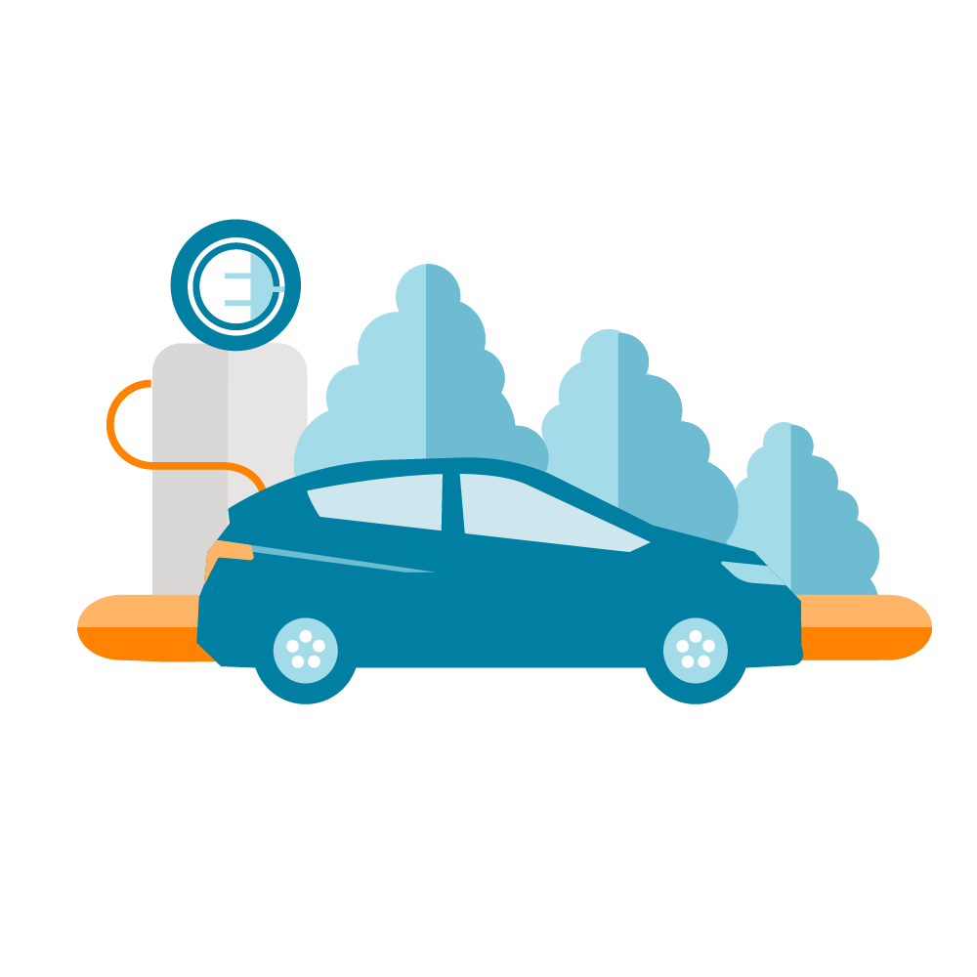



Why you should have EV Charging at your Building
Attracts and retains EV driving tenants
Supports Residents purchasing or leasing EVs through greater awareness and access to charging infrastructure
Demonstrates a commitment to sustainability
Increases Property Values
Notes:
EV sales to continue to increase year over year and the need for more investment in charging infrastructure will continue to grow.
Making the decision to provide access to EV charging infrastructure at your building can bring a number of benefits.

Slide 10
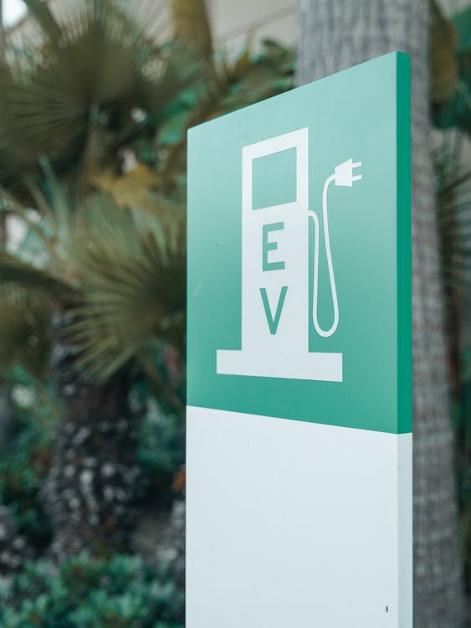
Increased Property Value Testimonials
“The units with EV chargers installed were getting a $5k to $8k premium”
A representative from The Henry
(Portland, OR)
“[~125 L2s] was a real selling point for the property as many of our residents drove Teslas and other EVs.”
A representative from The Madrone
(San Francisco, CA)
Notes:
Here are some quotes from building managers at a couple of the demonstration sites
The chargers added value to the condos
The chargers were a great recruiting tool

Slide 11
Charging at Home is Really Valuable to Residents
Where Charging Happens
Future EV adopters will increasingly live in MUDs
Residents will come to expect charging
Home charging provides range security
More than 30% people in US live in multi-unit dwellings (MUDs)
On The
Road
At Work
At Home
Notes:
Most charging is done or should be done at home.
Home charging is the most convenient and oftentimes the most affordable for EV drivers
Home charging gives drivers peace of mind and can reduce range anxiety
Chargers will be an expected amenity at MUDs in the near future

Slide 12
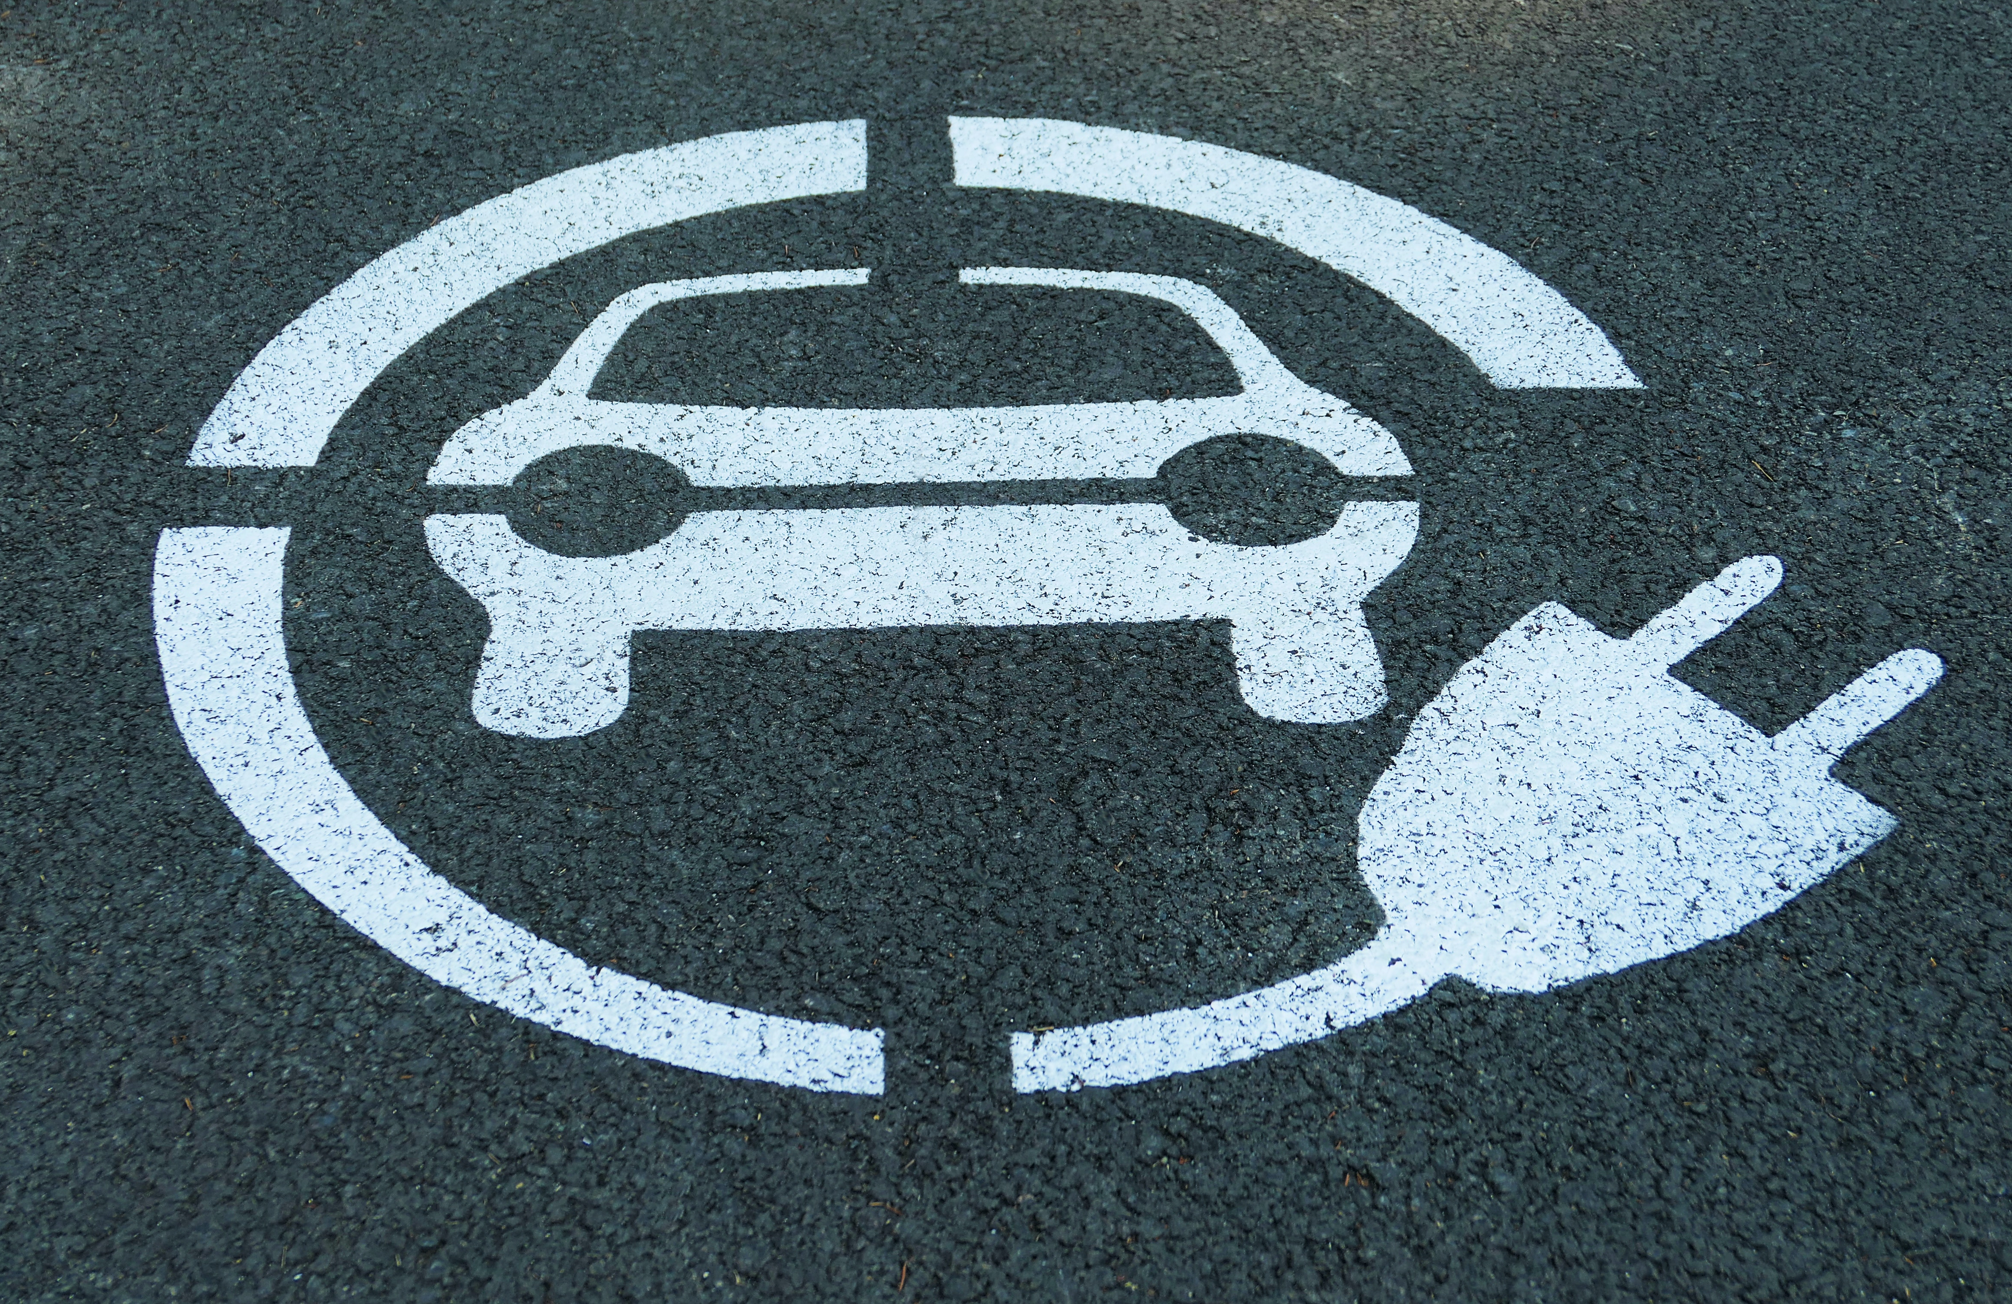
VCI-MUD Project Objectives Overview
Determine MUD barriers
Demonstrate Innovative Technologies
Analyze and Develop Results
Develop Toolkit
Disseminate Online Toolkit

Slide 13
EV Charging Challenges at MUDs
Cost & Cost Recovery
Energy & Demand Management
Ownership & Planning
Access Control
Design/ Site Layout
Notes:
Energy and Demand Management: How to maximize the convenience of charging (more chargers) while minimizing the cost and not overloading the circuit. What time you charge (TOU: time of use) can also have a big impact on electricity cost, so managing this is important
Access Control: Want to ensure that the people in the building won’t be blocked by someone freeloading.
Ownership and Planning: What is the plan for the building as EV adoption increases? You should think about the future need for charging so that you do not have to dive into 2nd charger project.
Design/ Layout: Where and how to make the chargers available; e.g. are there some extra visitor spots that can be converted to charging?
Cost/ Cost recovery: Upfront costs of installation of EVSE can be recouped by adding a modest fee for the electricity, and still be cheaper than offsite chargers. How will users be charged? (per kWh, per hour, etc)

Slide 14

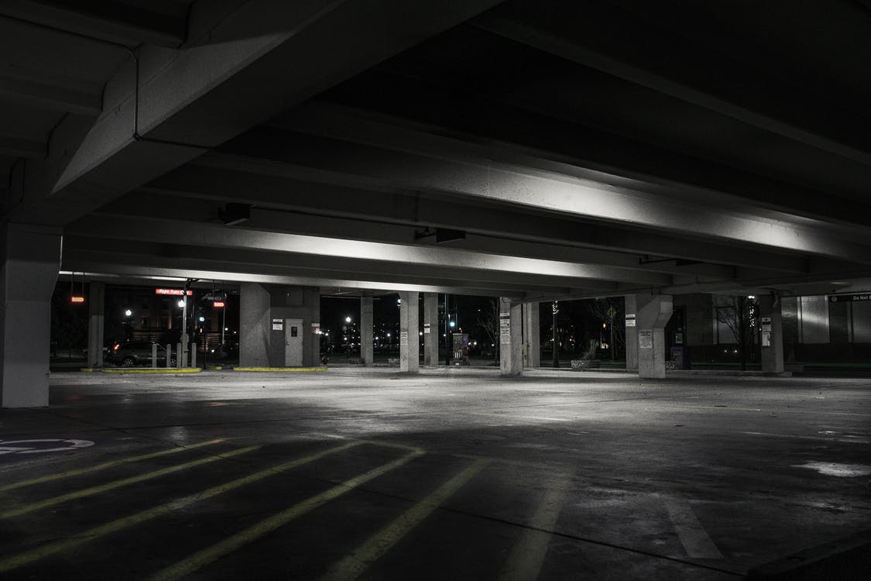




MUD Charging Installation Factors
  Limited electrical capacity
  Number of EVSE
  Parking constraints
  Allocation of installation costs
  Electricity rates and avoiding demand charges
P
Notes:
MUD demo site characteristics:
Many buildings face the barrier of limited electrical capacity
How many EV chargers should you install?
What is the parking situation like at your building? Are there dedicated spots or shared spots? Is it accessible to the public? Will you have to change parking policies when you install EV chargers
Allocation of installation costs (equitably) is a key decision in the installation process. Who pays for what?
Varying electricity rates (e.g., $/kWh, TOU, demand charges). Utilities charge different rates for electricity at different times of the day. Will you factor this into your charging rates?

Slide 15
Baseline Interview Results
Notes:
Those highlighted in red are the most common barriers at MUDs.
HOA Related: Common area management, Association approval and homeowner buy-in
Information and education: chicken and egg problem for EV adoption and EVSE need, need proper information for buildings owners/managers and HOAs on features and benefits
Parking limitation: Deeded parking and limited parking spaces, parking garage far away from electrical panel increasing cost
O&M cost: Power management and network subscription costs
Cost of installation: Installation cost of running electrical circuit and conduit for EVSE, the installation cost for electrical panel or service upgrade
Electrical related: Older building may not have enough electrical capacity, Distance from the electrical panel from garage

Slide 16
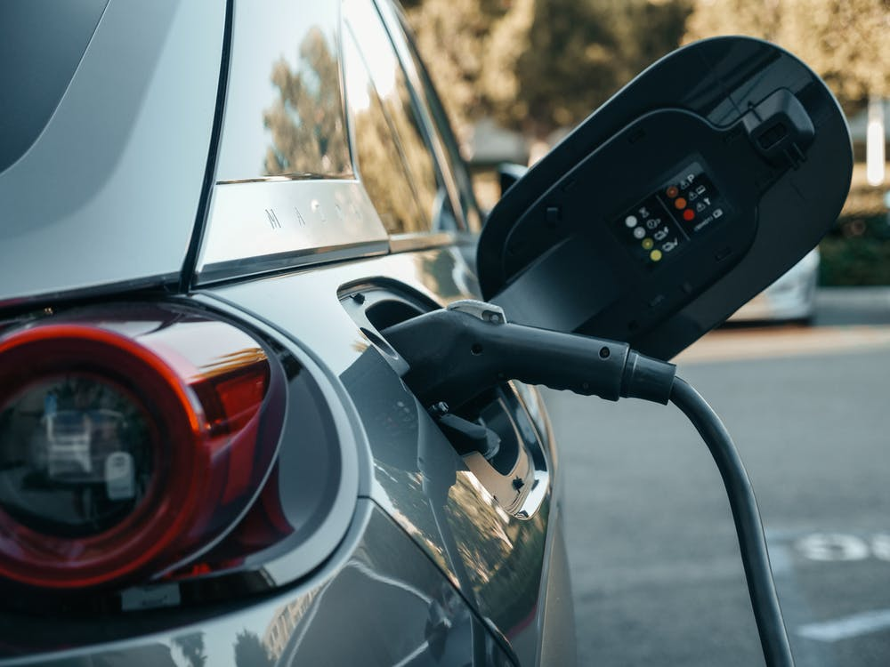
Technological Solutions Overview
Shared Charging Stations:
  Extra parking spots available
  Power-sharing option
  Have to move after finished charging
Dedicated to Individual Residents:
  Homeowner/deeded parking spots-increase home value
  Easiest for EV Driver, but often expensive
Offsite Charging (Independently Funded)
  Proximity really matters
  Amenities?
Notes:
There are innovative technology solutions available to address there barriers.
Whether you have a shared parking situation or a dedicated one.

Slide 17
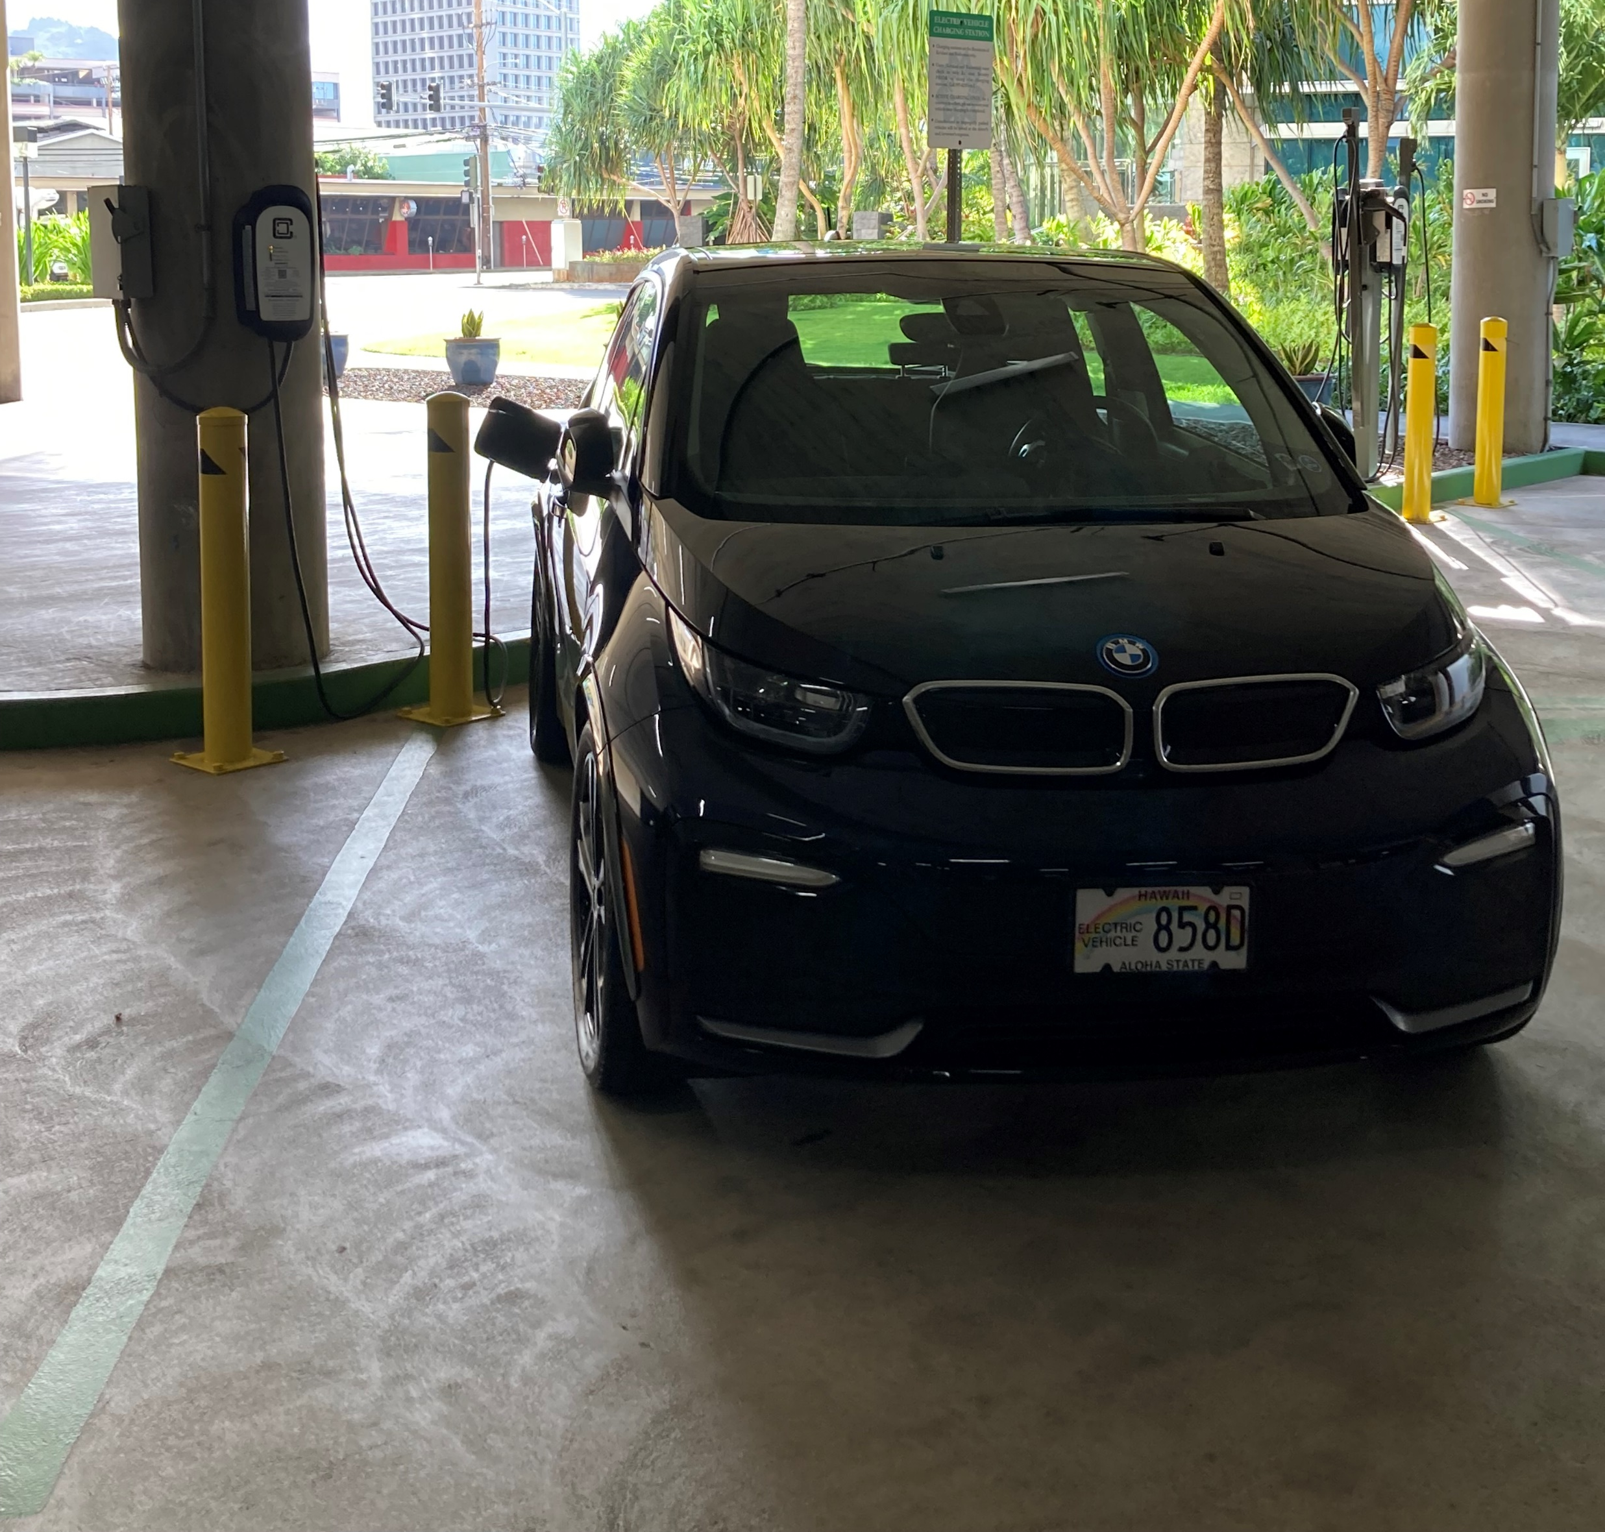
Shared Charging
  Unreserved parking or guest spaces
  Energy use usually tracked and billed to resident by vendor
  Fewer stations required to serve a given number of vehicles than dedicated charging
  Idle (Over-stay) fees can dramatically incentivize turnover
  OpConnect- Ko’olani, Honolulu
Notes:
You will likely have to initiate over stay or idle fees so that drivers do not stay plugged in longer than they should.
Idle fees will incentivize drivers to move their cars when they are done charging

Slide 18

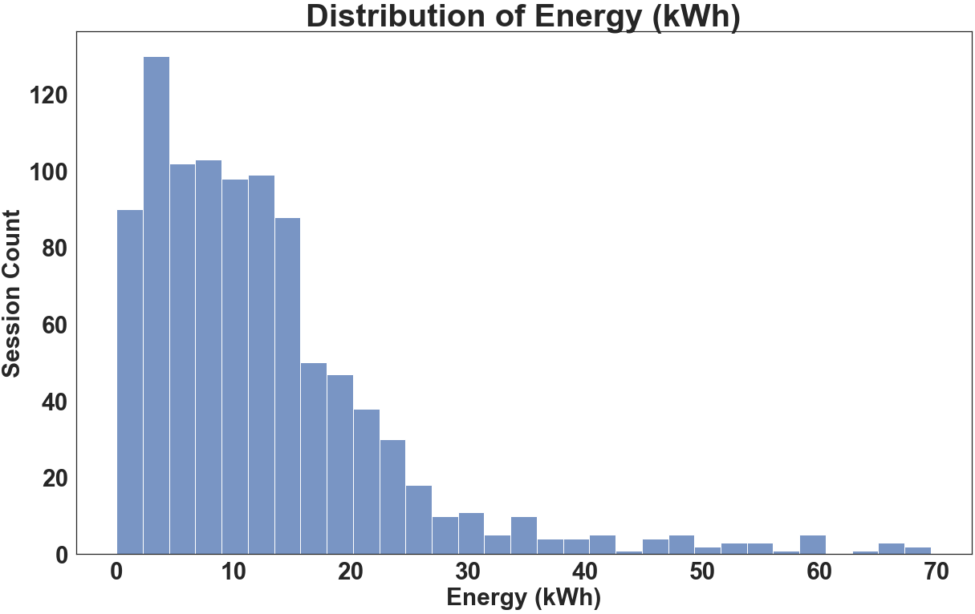
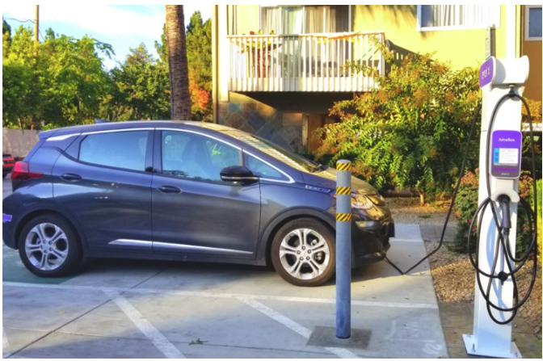
Shared Charging Data
VCI-MUD Demonstration Site
  EV Match - The Revere, Silicon Valley (Pictured)
  OpConnect - Ko’olani, Honolulu
  Liberty Plug-ins - The Brookwood, Atlanta, Ga
Demonstration data:
10-20 kWh/session
  2-4 hours avg
Up 5 sessions/day
  1-2 avg
Notes:
The demonstrations averaged about 2-4 of charging per session
This charger averaged about 1-2 sessions per day and up to 5 sessions max

Slide 19
Shared Charging Technologies
Technology Feature | When Does This Make Sense?
External controls on non-networked stations | Need management of “dumb” chargers
Reservations and access control | Non-secure parking facility High demand of charger use
Energy management | Limited electrical capacity High electricity rates
Notes:
External controls on non-networked stations allow you to manage a station without the “smart” charging capabilities
Reservations and access control allow the manager to restrict who can charge and when they can charge. Users can reserve times to charge their vehicles, this will limit frustration in drivers and allow them to plan in advance.
Energy management will limit the peak amount of electricity to avoid electrical overload. It will charge at a slower rate or stop charging if electrical capacity is about to be exceeded.

Slide 20
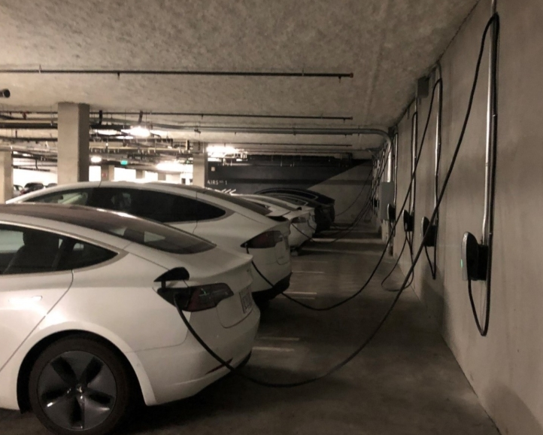
Dedicated Charging
Residents have reserved parking spaces
Power must be run to each space
Residents can leave car plugged in as long as wanted with no consequence
Tying energy use to meters is difficult
Consider how capital and operating costs are allocated
Load management benefits increase with scale
Notes:
Each parking space will need electricity, can be expensive but that costs may fall on the resident
Allocation of capital/operating costs is an important consideration if residents have reserved parking spaces and you do not wish to change parking operations
Load management will likely be needed if they are many EV chargers installed

Slide 21
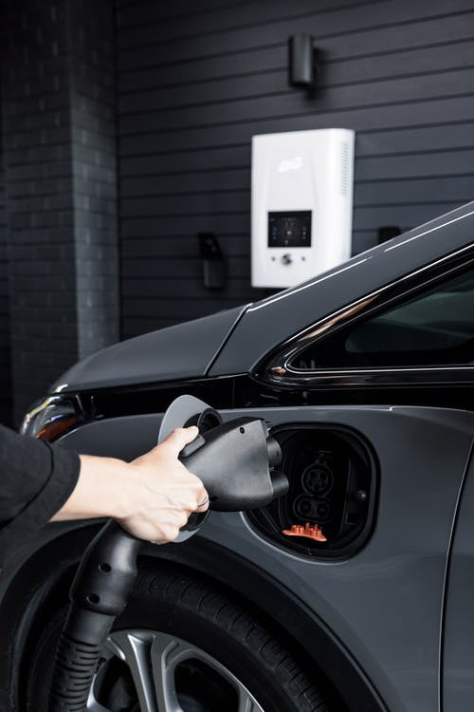
Dedicated Charging Data
VCI-MUD Demonstration Location:
  Cyber Switching - The Henry, Portland
  Powerflex - Madrone, San Francisco
Demonstration Data:
18-24 kWh/session avg
Avg session length: 12-24 hrs
Less than 20% of stations charging at once
Notes:
Drivers may leave car plugged in as long as they are parked
Higher kWh/session than the shared charging scenario because drivers leave their car plugged in for a while
Lower utilization of chargers because they are only serving 1 resident
20% of stations charging at once, however this was during covid so numbers were impacted

Slide 22
Dedicated Charging Technologies
Technology Feature | When Does This Make Sense?
Adaptive Load Management – Large Scale | Limited Electrical Capacity
Rotational Charging | Limited Electrical Capacity
Notes:
Adaptive load management will increase or decrease the amount of energy the chargers used based on the available electrical capacity
Rotational charging will turn on and off chargers so not all chargers are charging at once (For example, overnight when residents are all home). This will avoid an overload

Slide 23
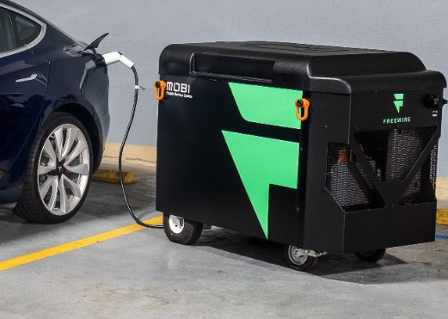
Mobile Charging
FreeWire Technologies
When does this technology
make sense?
Limited Parking capacity
Limited Electrical capacity
Valet or parking attendant on site
Secure Parking facility
  80 kWh energy capacity
  2 Level-2 charging ports (6.6 kW each)
Notes:
Move to spot where charging is needed
Since MUD resident sessions in shared use situations average 10-12 kWh per session, this figure shows that the Mobi could easily serve 4-5 charging sessions per day.
In a MUD application, one might expect a few shorter sessions in the evening with one overnight charging session. After a morning session, the last user would need to plug the unit in to charge throughout the middle of the day.
Could be a good interim solution for initial step to gauge and understand the MUD's charging needs
Minimum infrastructure requirement
Recharge with L2 EVSE or 240v outlet to charge
High purchase price

Slide 24
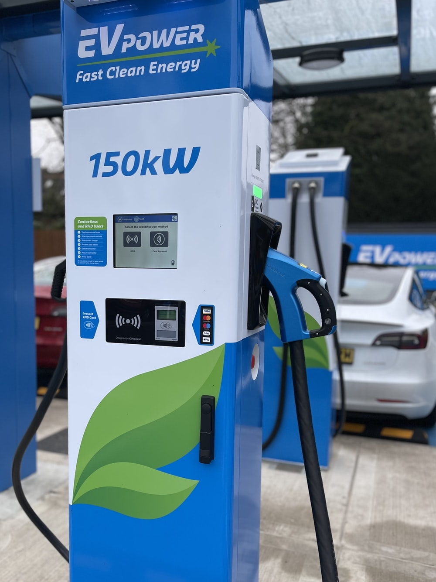
Offsite Solutions-DC Charging Hubs
DC Charging hubs are groups of fast chargers often nearby amenities like shopping centers or downtown areas
When does this technology make sense?
No available parking
No available electrical capacity
(If you’re a utility wanting to increase EV adoption)
  EV Drivers living in MUDs will tend to choose the most economic option for charging (factoring in their time)
    Expensive/no home charging -> Offsite Charger
Funding needed from independent entity:
Utility
City
Developers
Other large organization
Notes:
Not as convenient for drivers
Network of public access charging stations
Credit/Debit card initiation (no app)
Data collection and analytics are available

Slide 25
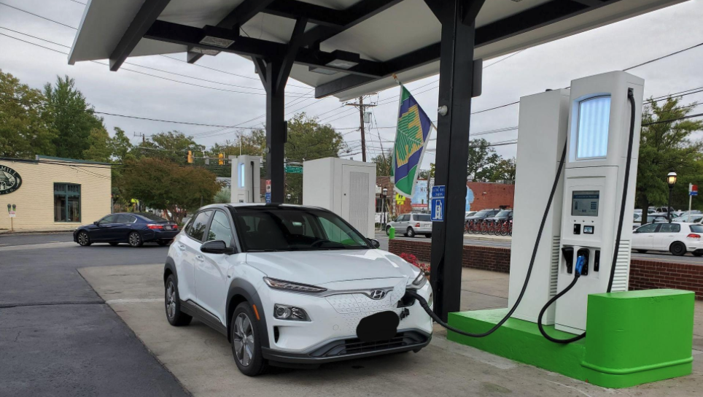
Offsite Solutions-DC Charging Hub (EVI)
VCI-MUD Demonstration Location:
Takoma Park Community Center
  Surrounded by 10+ MUDs
  1 DCFC (35kW) and 3 L2s
RS Automotive (Close by TPCC)
  Gas station turned charging hub
  4 DCFC on fuel islands + 2 L2s nearby
Notes:
Takoma Park was a good location because there were over 10 MUDs around the charging hub
Pricing Takoma Park: Pricing:
DC: $2.50 connection fee + $0.20/min
L2: $1.25 connection fee + $0.08/min

Slide 26
Demonstration Lessons Learned
Most charging sessions are 10-20 kWh whether shared, dedicated, or public
Load management benefits will be seen as buildings scale up the number of chargers
Off-site charging near MUDs can be valuable
Decision-making process can be very complicated at MUDs
Allocation of costs is an important consideration
Notes:
Difficult to find hosts to pilot technologies
Decision-making:
Apartment management needs a lot more engagement and education to understand the WHY and evaluate the demand of their own buildings;
Condominiums with HOAs are more complicated due to complicated situations of each unit owner’s car ownership and competing operation models moving forward
early adopters moving with dedicated circuits and charging model
Mass adoption and load-sharing or shared EVSE model?
Competitive parking resources
Cost allocation is a big challenge to navigate
Condo: Early adopters who paid for dedicated circuits or used up existing electrical capacity, who should pay for what?
Apartment: competing priorities for management and building owner, operation model and business case are important considerations for buildings to consider;
Load management or managed charging will have greater benefit for larger scale deployment:
Service more parking spaces with more plugs;
Avoided costs on electrical upgrades;
Great potential for demand response and grid optimization, looking forward to hearing the electric utilities’ take on how to best proceed efficiently;
Off-site solutions:
Good interim solution and have strong equity impact (RMI report), DCFC strategically placed at disadvantaged communities could grow TNC electrification, which is commonly used by disadvantaged communities, while also allowing these communities to adopt EV more confidently;
Similarly, an EVgo with UCLA also found MUD users do use the adjacent DCFC for their EVs like we observed in Takoma Park;
But the pricing and economics are still a challenge and strip the strong financial benefits of home-charging

Slide 27



Each MUD Situation Is Different
Consider the location’s Parking and Electrical situation carefully and early
Allocate costs to the stakeholders appropriately
Don’t skip over stakeholder engagement
Benefits become more apparent at higher scale

Slide 28
Incentives
Add local information here
The following link can be helpful:
https://plugstar.zappyride.com/tools/incentives

Slide 29
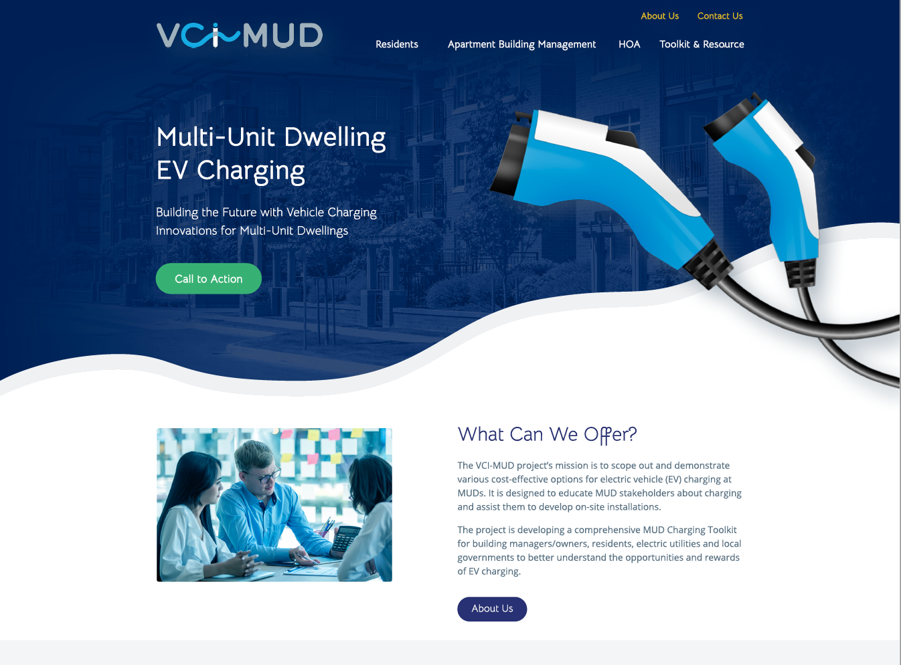
vci-mud.org
Notes:
Timeline:
Sept. – early-access testing and refinement;
Dec. – Public launch for full access;

Slide 30
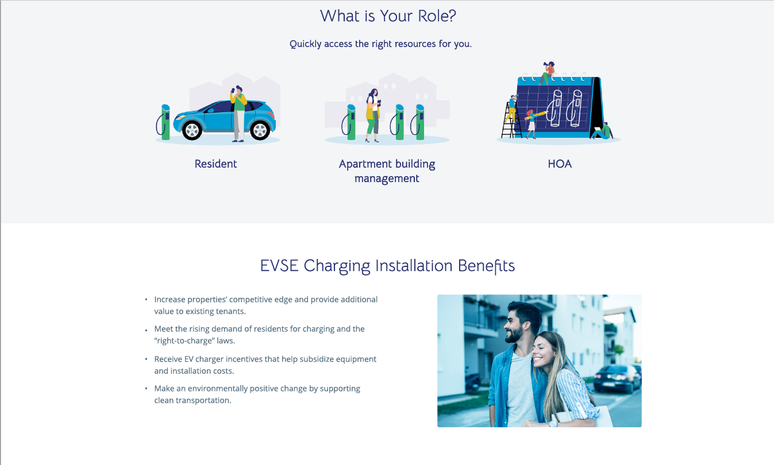

Slide 31

Resources can be found at:
VCI-MUD.org
Official Toolkit launch coming in July 2022!

Slide 32
Thank You!
Q & A
Contact information:

Slide 33
Supplemental Materials

Slide 34
Barriers Identified by Outreach Interviews
Barrier | Description
HOA Related | Decision-maker alignment and bylaw restrictions
Information and Education | Assumptions, misinformation, and lack of awareness limits interest in EV charger investment
Space Limitation | No excess parking spots and/or deeded spots
O&M Costs | Cellular networking, data subscription, and transaction fees
Installation Cost | Equipment acquisition, permits, engineering and planning, construction
Electrical Related | Adding electrical circuit and conduits, performing load studies, upgrading electrical panel or service, utility delays
Usage | Unsecured parking allows non-resident charger use No incentive to move after finished--no idle fees
Network Signal | Weak internet signal in garages

Slide 35
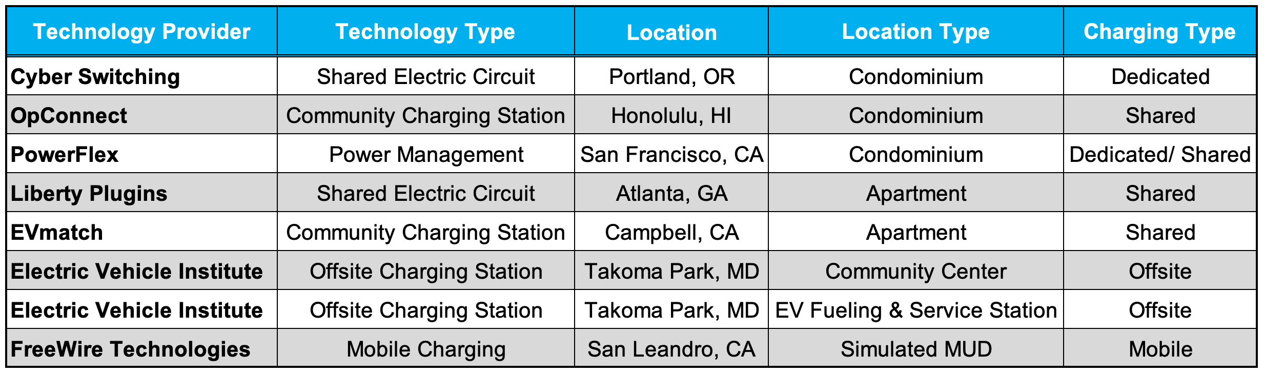
Technology Demonstration Summary

Slide 36
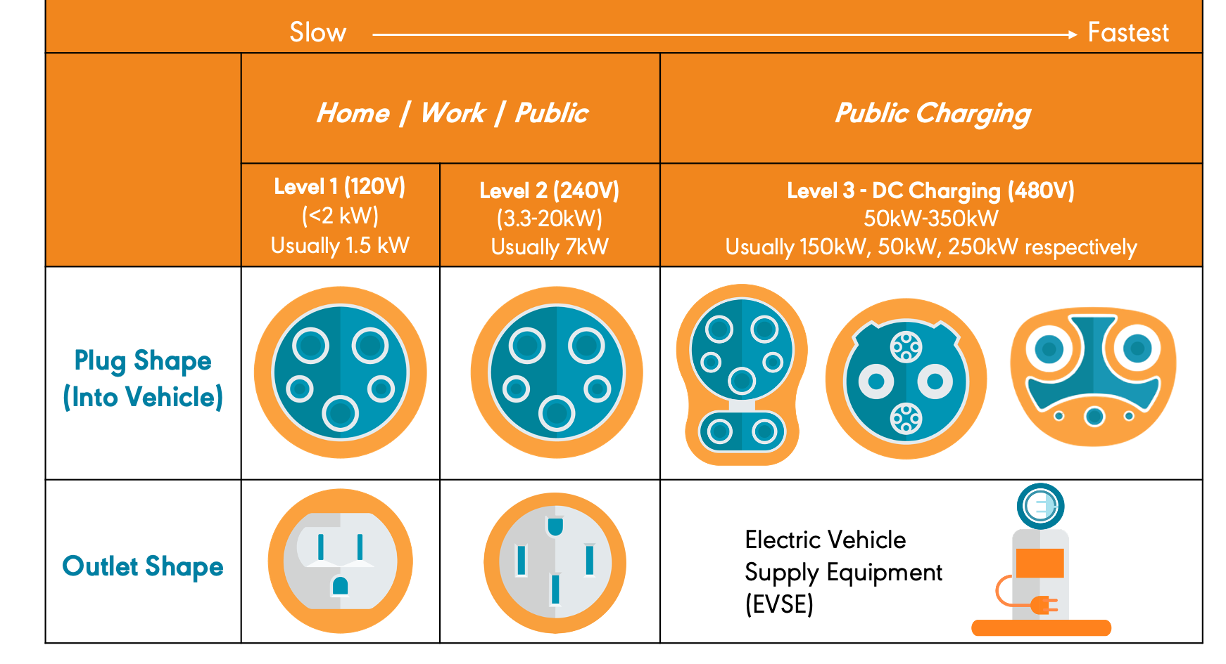

Types of Electrical Vehicle Charging
36
Notes:
And then quickly covering the types of charging that are used to refuel electric cars.
We’ll be focusing on Level 2 charging stations today as those are the most commonly found public chargers.

Slide 37
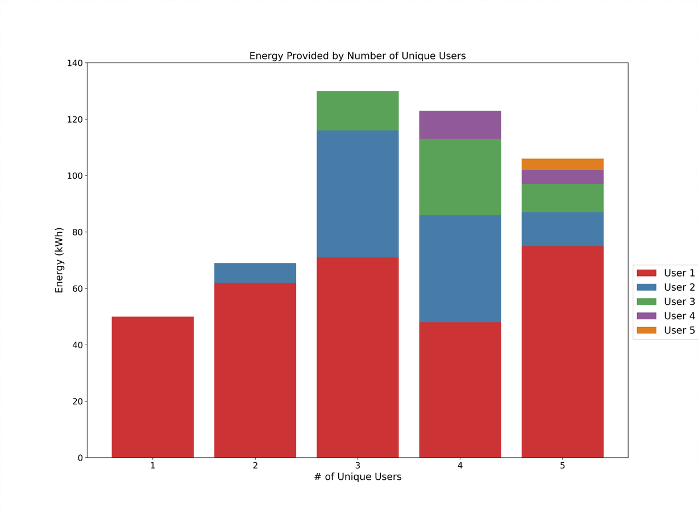
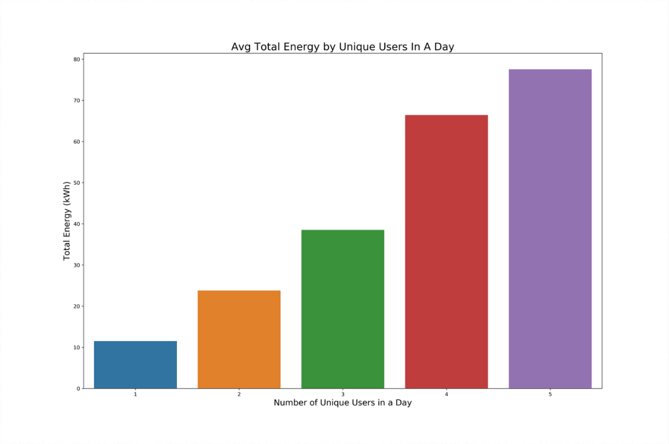
Shared Charging Analysis
10-20 kWh/ session typical
Up 5 sessions/day, 1-2 typical
2-4 hours/session, plus overnight
37

Slide 38
Business Case Analysis
General Technology Observations:
  Charging capability adds value to the building
  May increase equipment cost but lower installation cost, for example, by avoiding a service panel upgrade
  May offer lower operating costs than fully-featured commercial systems
  Benefits become more apparent at higher scale
  Achieving cost recovery is difficult, but some products offer a way to recoup cost and help fund scaling up capacity in the future.
  Can help differentiate cost plans or exclude non-building usage to preserve charger availability.
Shared
  Fewer stations required to serve a given number of vehicles
  Over-stay fees increase utilization of chargers by minimizing idle charger time.
Dedicated
  Simpler to allocate capital costs to users
  Larger number of ports lowers per-port cost
Offsite:
  No capital costs to site
  Higher costs to end-users per charge/kWh
Notes:
Network of public access charging stations
Credit/Debit card initiation (no app)
Data collection and analytics available

